Slide 1

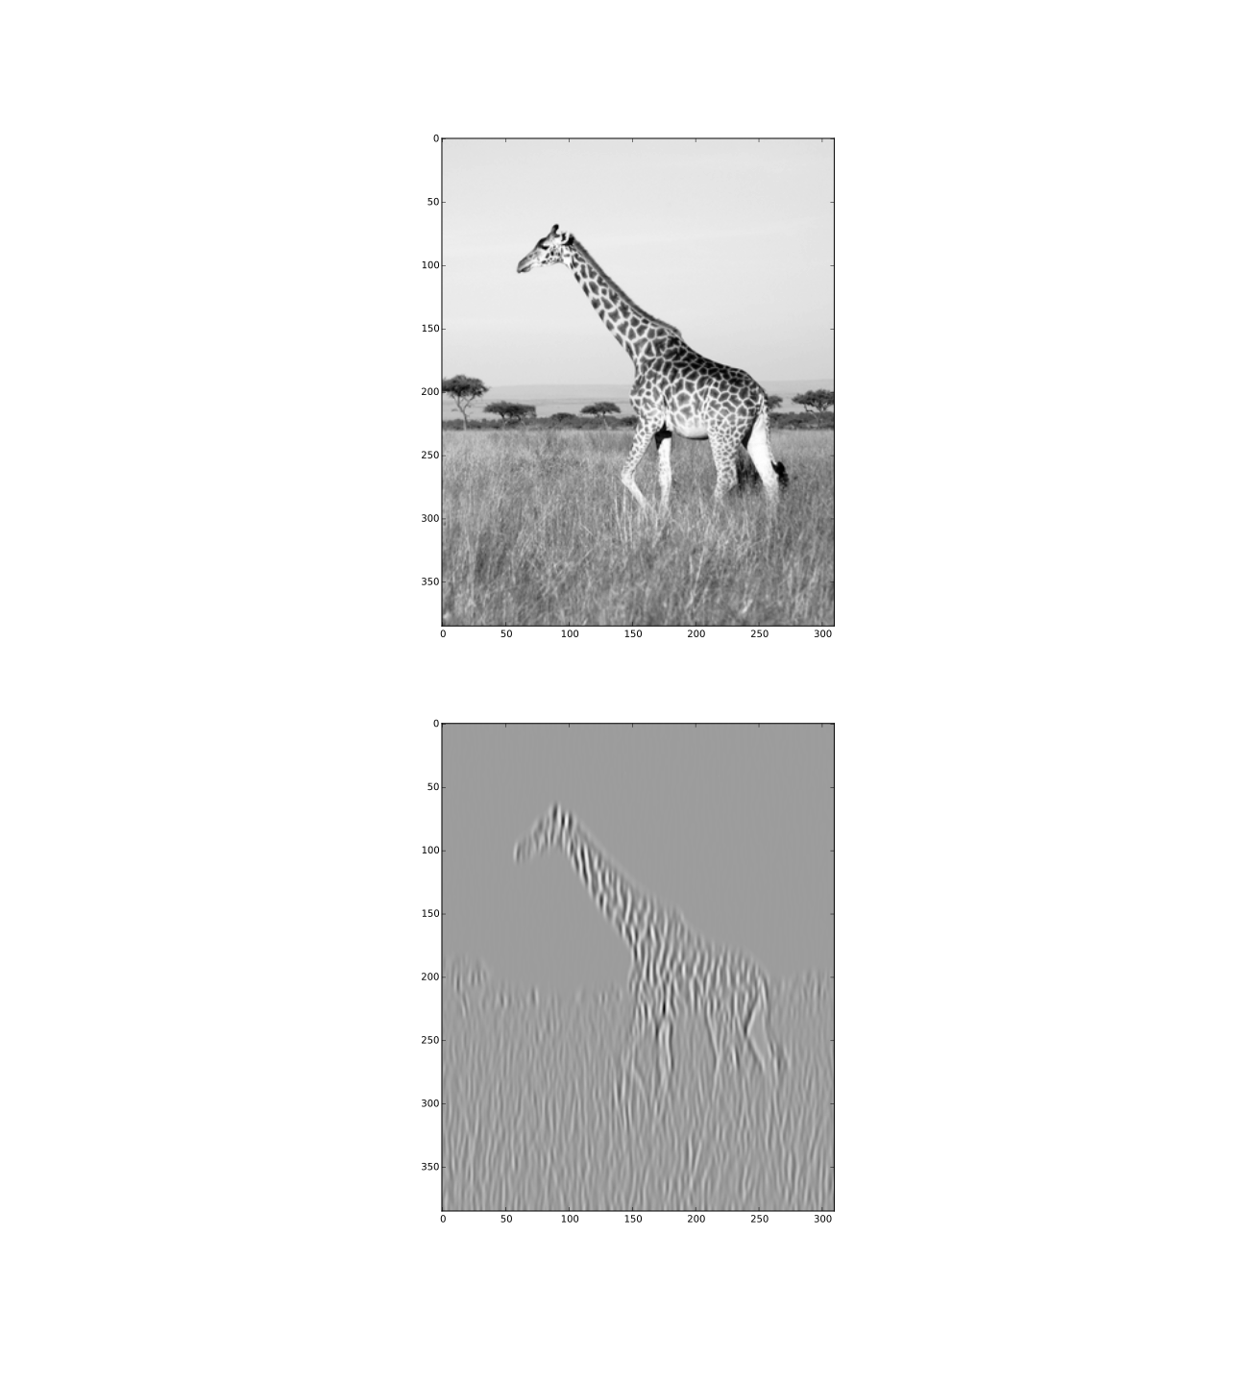
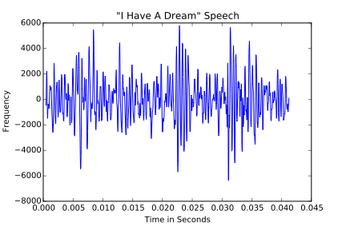
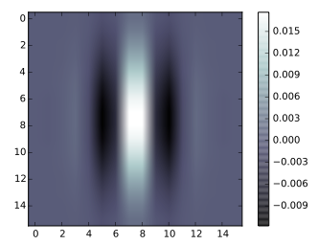
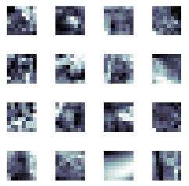
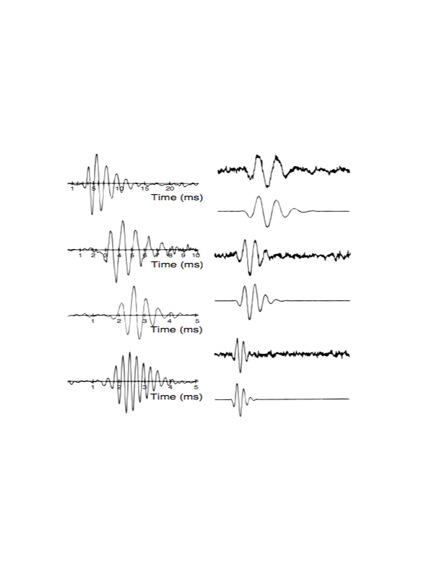
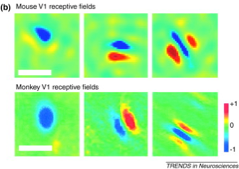
Demonstration of Efficient Visual and Auditory Neural Coding
Mary Makarious^{1,2,3}, Griffin Moe³, Mark V. Albert³
¹Department of Biology, Loyola University Chicago
²Bioinformatics Interdisciplinary Program, Loyola University Chicago
³Department of Computer Science, Loyola University Chicago
Motivation
Traditionally, visual processing and auditory processing were studied as distinct methods with separate research groups, terminology, and approaches; however, recent discoveries show that these two sensory areas are performing essentially the same computation, with only a change in inputs. This work is aimed towards a professor teaching an introductory neuroscience or computational neuroscience class, and changing inputs would be simple with a phone application.
Results
Future Objective
The next step would be to work on the user interface of the phone application, making it as easy as possible to use and compare the the known filters with the user-generated filters. The end goal is to release the phone app in the Google Market.
Efficient Coding Hypothesis: Theoretical model proposed as a way of understanding neural responses by reducing redundancy in the neural code for natural sensory experiences.
Visual Neural Code
Auditory Neural Code
Conclusion
Our program analyzes visual and auditory scenes using the same efficient coding method — in this case, ICA. It is clear in using it that different types of images and sounds have different impacts on the resulting code — although these results are not presented in this poster. However, the code is ready to port into an Android application to make it more accessible to users, allowing them to compare resulting codes for different images and sounds for themselves.
Abstract
We can understand neural responses using the concept of a receptive field. These receptive fields answer “what” a neuron responds to. We demonstrate that these neurons form an efficient code by deriving similar neural receptive fields from an efficient coding of natural scenes. Understanding the 2D Gabor-like visual cortex simple cell responses as an efficient coding of natural scenes has been thoroughly studied. Pictures can derive a visual code using independent component analysis (ICA) on randomly sampled pixel patches. The resulting linear filters are readily visualized as receptive fields. Similarly in the auditory domain, we provide vocalizations as input to generate gammatone filters; resembling the response properties of neurons that make up on auditory nerve.
Original
“I”
“Have”
“A” “Dream”
Above is an example of an original image to be encoded.
Above is an example of an original sound to be encoded.
A visual receptive field. This depicts a neuron selective to vertical stimuli
Samples
References
Albert MV, Field DJ (2009) "Neural Representation and Coding."Encyclopedia of Perception, Ed. E.B. Goldstein et al., SAGE Press. Huberman, Andrew D., and Cristopher M. Niell. "What Can Mice Tell Us about How Vision Works?" Trends in Neurosciences 34.9 (2011): 464-73. Web. Lewicki, Michael S. "Efficient Coding of Natural Sounds." Nature Neuroscience Nat. Neurosci. 5.4 (2002): 356-63. Web. Olshausen BA, and Field DJ. (1996). "Emergence of Simple-Cell Receptive Field Properties by Learning a Sparse Code for Natural Images." Nature, 381: 607-609. Olshausen BA, and Field DJ. (1996). "Natural image statistics and efficient coding." Network: Computation in Neural Systems, vol. 7, 333-339
These are random samples taken from the original photo.
These are random samples taken from the original sound clip.
Produced Filters
Methods
Natural images and sounds are collected using the phone camera/microphone. (Pictures of rocks, trees, etc. and sounds ranging from anharmonic environmental sounds to harmonic environmental sound) The image or sound was randomly sampled to create tens of thousands of smaller images patches (8x8 pixels) or audio clips (100 samples in size) The samples were encoded using an efficient coding technique, specifically independent components analysis (ICA). The resulting filters were then visualized producing the expected Gabor-like filters for the images and gammatone filters for the sounds, which match similar receptive fields measures directly from neurons in the brain.
The figures above are the resulting visual filters from ICA. These filters resemble the Gabor filter-like response properties of a V1 simple cell.
The figures above are the resulting auditory filters from ICA. A subset of these filters resemble the gammatone response properties of neurons that make up the auditory nerve.
Acknowledgements
This work was supported by the “Sustaining Excellence” HHMI grant #52008101, enabling the Loyola University Chicago FYRE program, and supporting the LUC Computer Science Undergraduate Summer Research Program, also a thank you to Suzanne Greenwood for spending her summer working on this project.
Actual Filters
The figure above illustrates measured visual neural receptive field filters.
(Huberman, 2011)
The figure above shows measured auditory neural receptive field filters.
(Lewicki, 2002)

